Slide 1
11055 / Programming for Design
16 September 2019 / Semester 2 Week 7
Programming for design
Week 7 – Quality
Simon Thompson

Slide 2
11055 PfD
16/9/19 – S2W7
Week 6
We looked at Programming Paradigms
We looked at Object Orientation
We did more on our project

Slide 3
11055 PfD
16/9/19 – S2W7
Paradigms

Slide 4
11055 PfD
16/9/19 – S2W7
Procedural & Functional
A procedural program starts at the top and progresses through the procedural statements that you have written, until it is completed.
A functional program breaks up the instructions into discrete ‘functions’ that pass information between them. Each function may no nothing about the others and works to complete only its designated purpose without any understanding of the whole program.

Slide 5
11055 PfD
16/9/19 – S2W7
Object Orientation
Class
Abstraction
Encapsulation
Interface
A class holds our object code
The class abstracts the object to its base properties and methods
The class encapsulates the object so that it can only be used the ‘right’ way
The class exposes an interface so that other code can use it.

Slide 6
11055 PfD
16/9/19 – S2W7
Object Orientation
Inheritance
Polymorphism
A class can be a subtype of another class, when this is true it inherits all the properties and methods of its parent
When a child class is stored in a parent class variable, it will still use the correctly use code for any overloaded methods

Slide 7
11055 PfD
16/9/19 – S2W7
Comments
Use comments to describe your code so when someone else (or yourself in a week) comes to read it they can understand what you have done.
// the next line will iterate the list
/* the following function will ensure that the variables passed to it are numbers before doing any math. */
Commenting in your code is very important.
Use // to comment an individual line
Use /* */ to comment a block

Slide 8
11055 PfD
16/9/19 – S2W7
Why are we here?
Course Objectives
Identify and critique various programming languages and how they can be utilised within the field of design;
Analyse and apply computer programming techniques through the use of features including loops, variables, functions and objects; and
Create engaging interactive media for different various contexts.

Slide 9



11055 PfD
16/9/19 – S2W7
This week!!!
Quiz
Project 1
Project 2
20% Week 4
Mostly module 1, with maybe a variable question or five
30% Week 7
A JavaScript project using the tools we have learnt
50% Week 13
A Python project using the tools we have learnt

Slide 10
11055 PfD
16/9/19 – S2W7
Project 1 (assignment 2)
Basic programming sketch. In this project you will use your newfound programming skills to create a self portrait in p5.js
The format of the sketch is up to you - it might a literal or abstract representation - using typography, lines or shapes.
Project will include the following:
Flow chart(s) detailing what your program will do.
Set of pseudo-code detailing what how your program will operate.
HTML file(s) that allows your application to be interacted with.
JavaScript file(s) that contain the code for your application.
To be submitted on GitHub, in the ./Project1/[your student number] directory structure

Slide 11
11055 PfD
16/9/19 – S2W7
Quality
The quality of your code can be measured in many ways;
Ease of readability
Efficiency of resources
Convenience to the user
But the first measurement is always functionality

Slide 12

11055 PfD
16/9/19 – S2W7
Does it do what you wanted?
If your code doesn’t do what you want then you won’t use it.

Slide 13
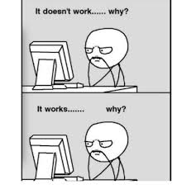
11055 PfD
16/9/19 – S2W7
Does it do what you expect?
If your code doesn’t function how it is expected then no one will be able to use it.

Slide 14
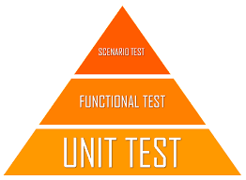
11055 PfD
16/9/19 – S2W7
A simple rule – test your code
Quality is proven through ensuring that things work as expected.
Each function that you write needs to be Unit Tested.
When you then write programs that use that function, you would then functional test the programs.
Finally when you have scenarios of how the program will be used, you would do specific scenario testing.

Slide 15
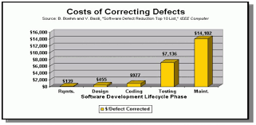
11055 PfD
16/9/19 – S2W7
Testing is a big and important subject…
This is where unit testing is

Slide 16
11055 PfD
16/9/19 – S2W7
Types of unit tests you can do
Data type testing
Boundary Testing
Code Coverage

Slide 17
11055 PfD
16/9/19 – S2W7
A function to test
function mytestable (word, numA, numB) {
var product = numA / numB;
if (word.length < 74) {
return product + “ is the “ + word;
} else {
return “that’s a long word”;
}
product++;
}

Slide 18
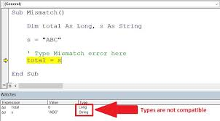
11055 PfD
16/9/19 – S2W7
Data Type Testing
The first thing we can check is what happens if we don’t pass the correct data typed variables to our function, does it error? Or worse does it return odd results?

Slide 19
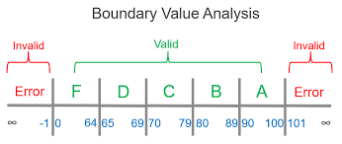
11055 PfD
16/9/19 – S2W7
Boundary Testing
We can then test boundaries of the variables we are passing to the function.
What might happen if we pass a 852722129082389850930320298 to our number?
What about a 0?
Or a -0.067844?

Slide 20
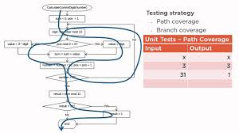
11055 PfD
16/9/19 – S2W7
Coverage Testing
We should also test that all parts of the function can be reached.
Are there decisions that lead to branches that might not be called?
Is there code after break points that will never be reached?

Slide 21
11055 PfD
16/9/19 – S2W7
A function to test
Before we start writing tests we can ask the programmer about where are the comments, and why the variable called product is being used to store the result of a division?
function mytestable (word, numA, numB) {
var product = numA / numB;
if (word.length < 74) {
return product + “ is the “ + word;
} else {
return “that’s a long word”;
}
product++;
}

Slide 22
11055 PfD
16/9/19 – S2W7
A function to test
Data Type testing?
function mytestable (word, numA, numB) {
var product = numA / numB;
if (word.length < 74) {
return product + “ is the “ + word;
} else {
return “that’s a long word”;
}
product++;
}
Boundary testing?
Coverage testing?

Slide 23
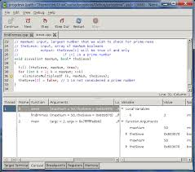
11055 PfD
16/9/19 – S2W7
Debugging
Reading your code
Commenting you code
Putting log/output statements everywhere
Debuggers
Watch/Break Points/Step

Slide 24
11055 PfD
16/9/19 – S2W7

Slide 25
Exercise 1
11055 PfD
16/9/19 – S2W7
Cleaning up GIT!
Make sure you commit and push all your changes into your branch.
Complete a pull-request with all your current changes.
**** Once I have actioned the pull-request
Switch to the master branch and pull origin (this will bring the full master branch onto your machine)
Stay in the master branch
Move your current working directory into the Exercises folder
Commit your changes (in the master branch)
Push Origin
********
You can now switch back to your branch
Now once you have done all this, if you haven’t already – delete your branch, and create a new branch from the master (this will have the new exercise and project1 folders for you to use)

Slide 26
Exercise 2
11055 PfD
16/9/19 – S2W7
Create a canvas that when you click on it, it creates a ball where you click.
Each ball should be an order of magnitude bigger than the last ball.

Slide 27
Exercise 3
11055 PfD
16/9/19 – S2W7
Limit the number of balls it will create to a number you determine. (e.g. 3 or 5 or 10)
When you reach the number of balls you have decided, don’t create any more balls, even if you keep clicking on the canvas.

Slide 28
Exercise 4
11055 PfD
16/9/19 – S2W7
When you have reached your number of balls, - if you click again, make it so that all the balls start to fall towards the bottom of the canvas.

Slide 29
Exercise 5
11055 PfD
16/9/19 – S2W7
Make it so you can see it falling (slowly or fast – you decide)
setTimeout(function(){
for (var j = 0; j < arr.length; j++) {
arr[j].drop();
}
}, 2000);
If you click again – make them start rising towards the top of the page.

